Slide 1




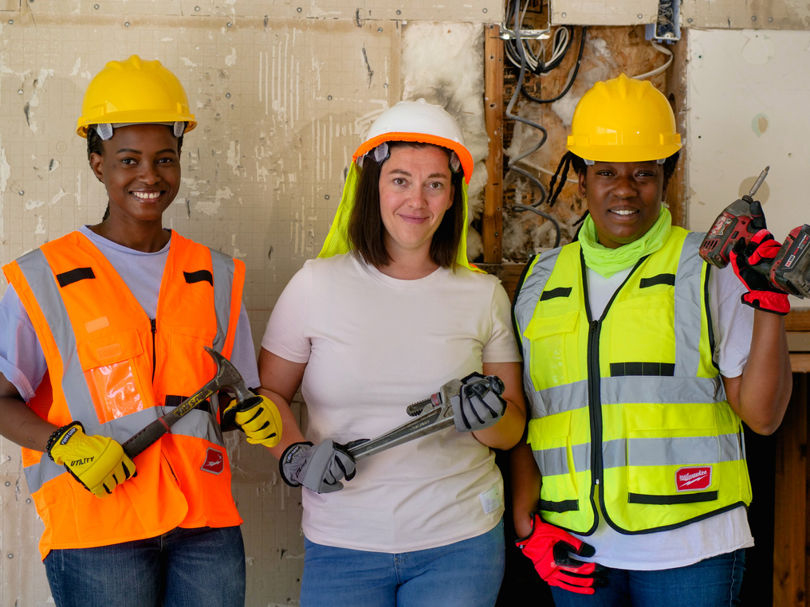
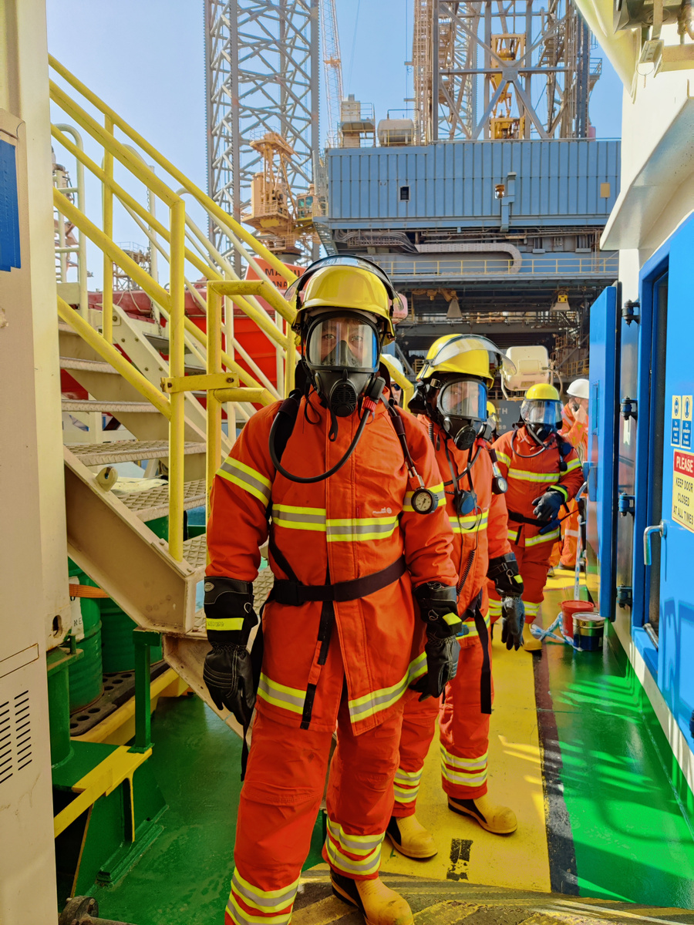
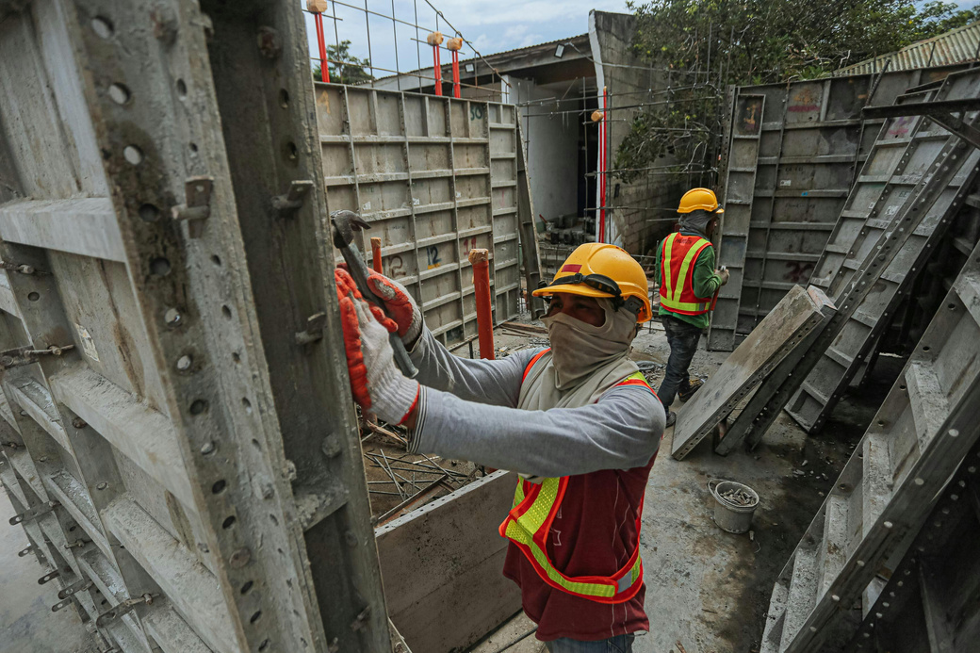
PPE SYSTEM
Home
Services
Features
About Us
Let’s Talk
WORKPLACE SAFETY PPE DETECTION SYSTEM
Automated Real-Time Safety Compliance Using YOLOv8
Team Members:
DeMarcus Crump
Chloe Tu
Project Tier: Tier 2
ITAI 1378 - Computer Vision
Date: December 3, 2025

Slide 2


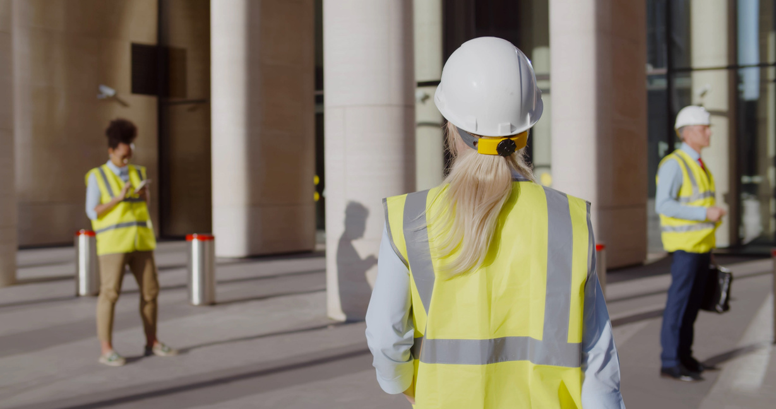
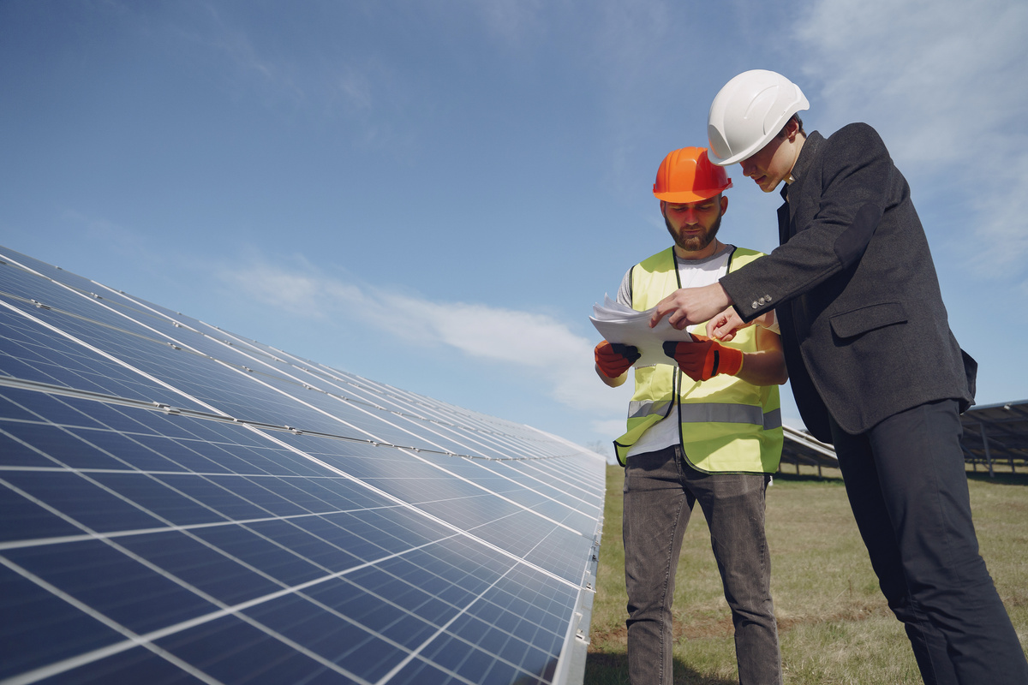

PPE SYSTEM
Home
Services
Features
About Us
Let’s Talk
THE PROBLEM & MOTIVATION
The Problem: Construction Safety
20% of workplace fatalities occur in construction
Main cause: PPE non-compliance (workers not wearing safety equipment)
Manual safety inspections are:
Slow and inconsistent
Cannot monitor all workers continuously
Reactive (catch violations after incidents)
Result: Preventable injuries and deaths

Slide 3
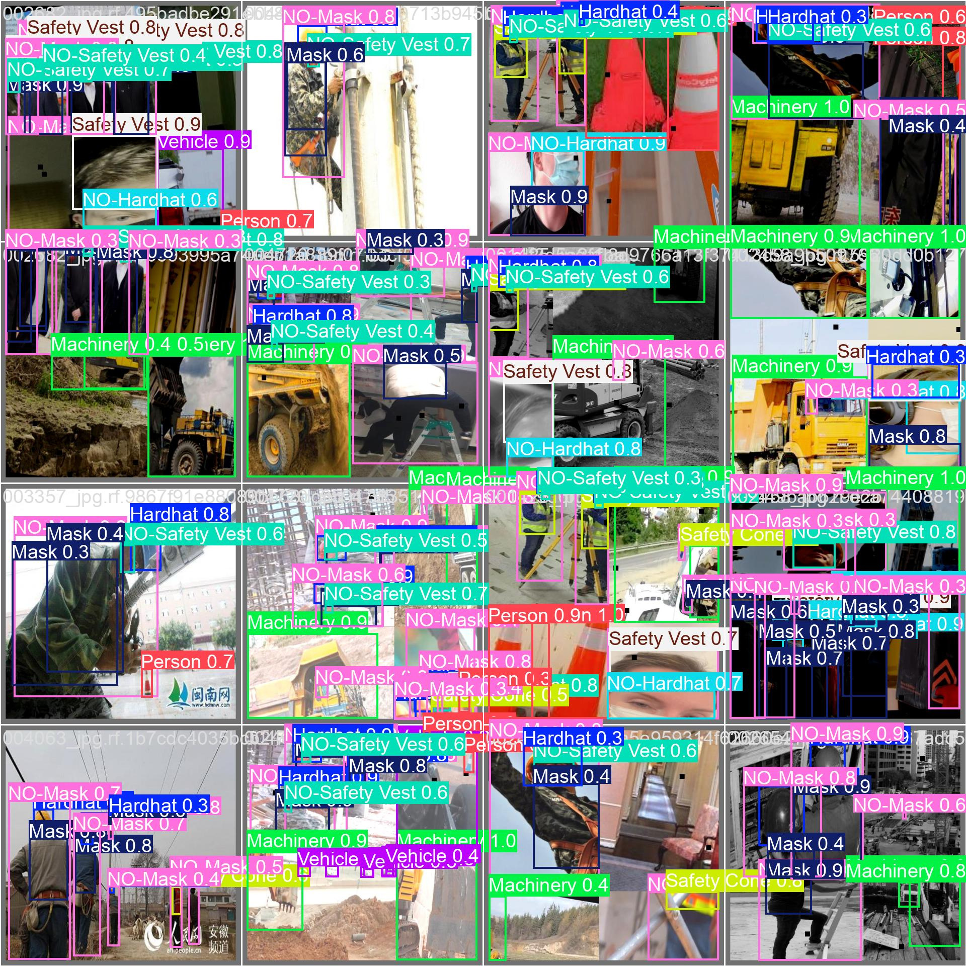
PPE SYSTEM
Home
Services
Features
About Us
Let’s Talk
OUR SOLUTION OVERVIEW
AI-powered computer vision system for automated PPE detection
How It Works:
1. Input: Image from construction site camera
2. Processing: YOLOv8 model analyzes image
3. Detection: Identifies PPE items and violations
4. Output: Bounding boxes + compliance alerts
5. Speed: Real-time (66 FPS)
Key Capabilities:
Detects: Hardhats, Safety Vests, Masks
Flags violations: NO-Hardhat, NO-Safety Vest, NO-Mask
Continuous 24/7 monitoring
Immediate violation alerts

Slide 4
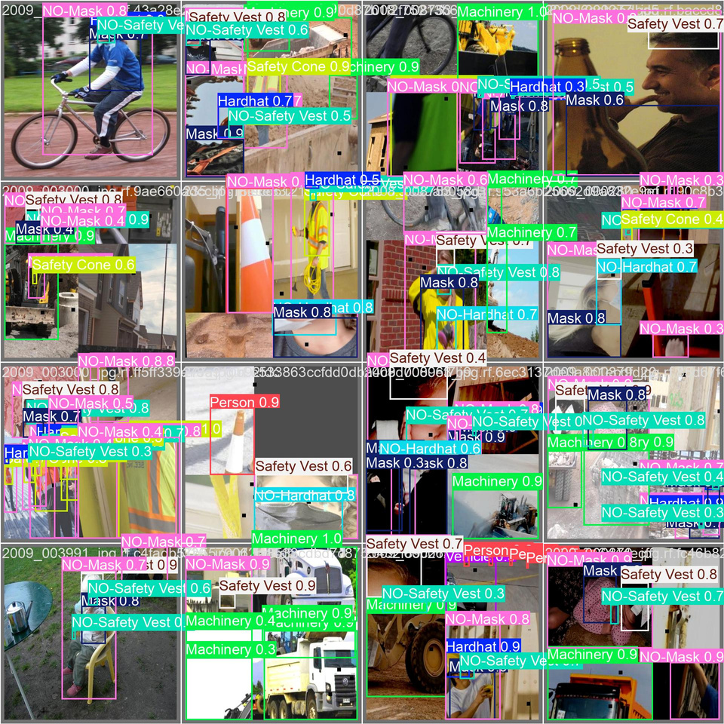

PPE SYSTEM
Home
Services
Features
About Us
Let’s Talk
TECHNICAL APPROACH - MODEL
Model Choice:
Comparison:
Architecture: YOLOv8s (You Only Look Once v8 Small)
Task: Object Detection
Parameters: 11.2 million
Pre-training: COCO dataset (80 classes)
Fine-tuning: Construction site images
Choice | Model | Speed | Accuracy
Too simple | YOLOv8n | 120 FPS | 75%
✓ Selected | YOLOv8s | 66 FPS | 77%
Too slow | YOLOv8m | 35 FPS | 81%
Why YOLOv8s?
✓ Real-time performance (66 FPS)
✓ Balance of speed and accuracy
✓ Single-pass detection (efficient)
✓ Production-ready

Slide 5
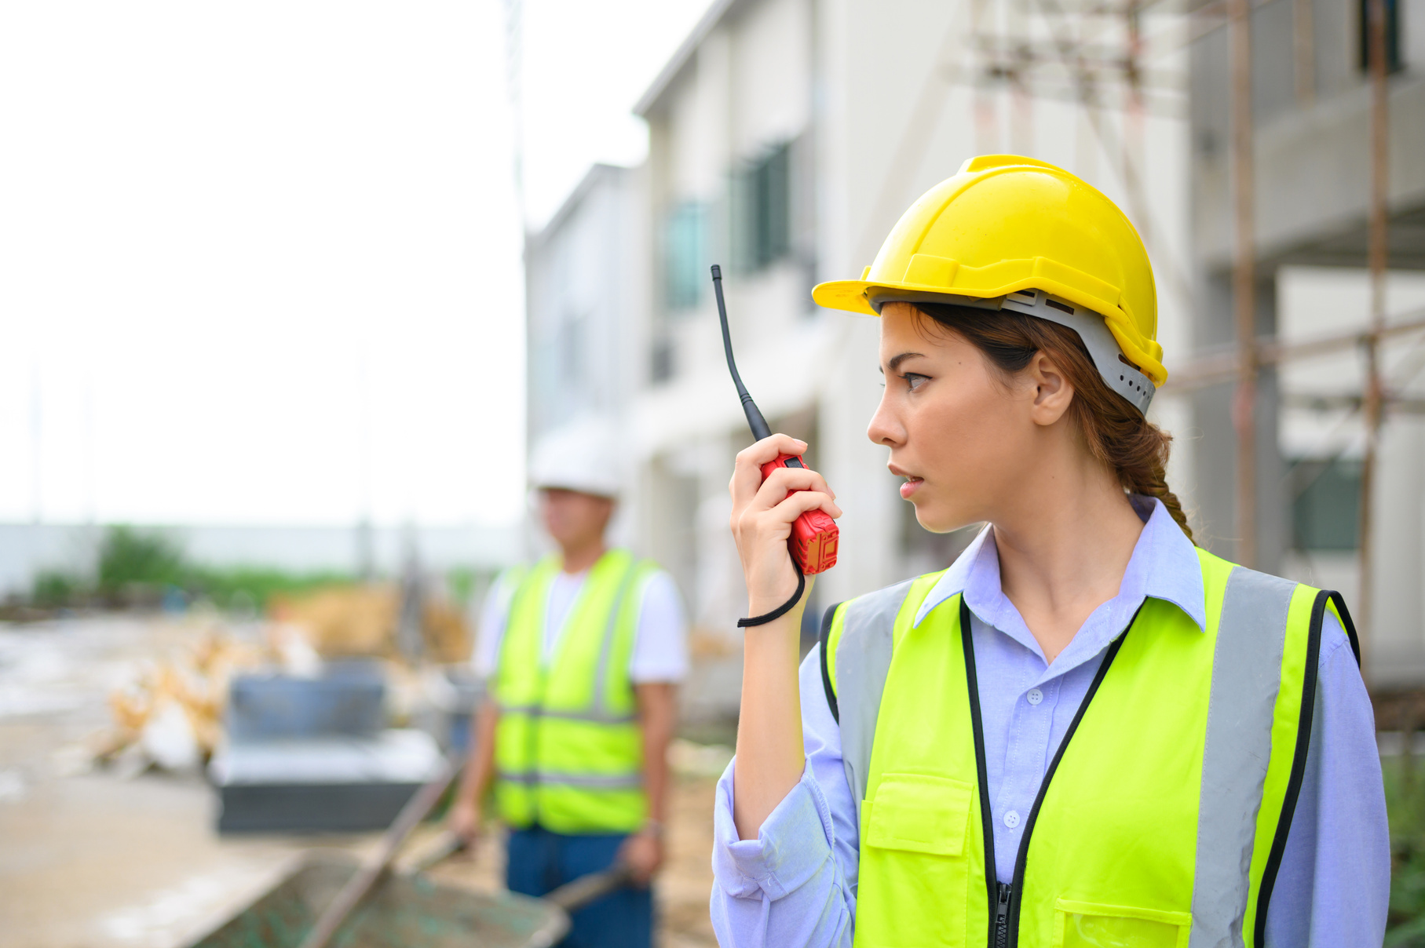
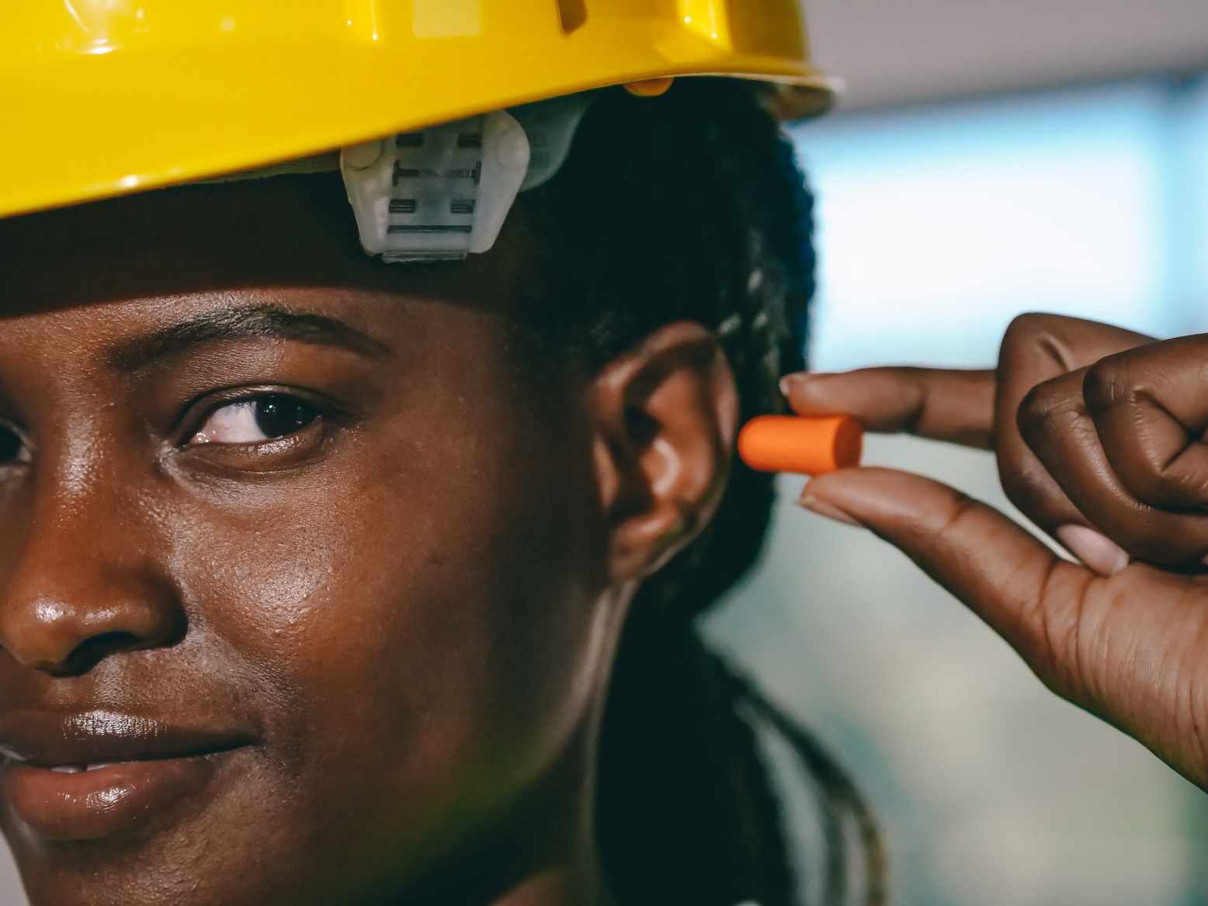

PPE SYSTEM
Home
Services
Features
About Us
Let’s Talk
TECHNICAL APPROACH - ARCHITECTURE
Architecture Diagram:
Output
Annotated Image
+ Compliance
Input Image (640x640)
Safety Analysis
- PPE check
- Violations
- Alerts
Preprocessing
Resize
Normalize
YOLOv8 Model
Backbone
CSPDarknet
Neck
PAN
Head
Detection
Post-Processing
- NMS
- Confidence
Filtering
← Feature extraction
← Multi-scale fusion
← Bounding boxes
+ Classes

Slide 6
PPE SYSTEM
Home
Services
Features
About Us
Let’s Talk
DATASET & PREPROCESSING
Data Source
Data Split (Stratified):
Name: Construction Site Safety Image Dataset
Source: Roboflow (via Kaggle)
Size: 2,801 images
Format: YOLO annotations (bounding boxes)
Training: 1,955 images (70%)
Validation: 423 images (15%)
Test: 423 images (15%)
Preprocessing Steps:
Classes (10 total):
1. Stratified Splitting - Maintain class balance
2. Data Augmentation:
Mosaic (combine 4 images)
Mixup (blend images)
Copy-paste (add objects)
Rotation (±20°)
3. Image Resizing - All images → 640x640 pixels
PPE Items | Violations | Context
Hardhat | NO-Hardhat | Person
Safety Vest | NO-Safety Vest | Safety Cone
Mask | NO-Mask | Machinery, Vehicle

Slide 7
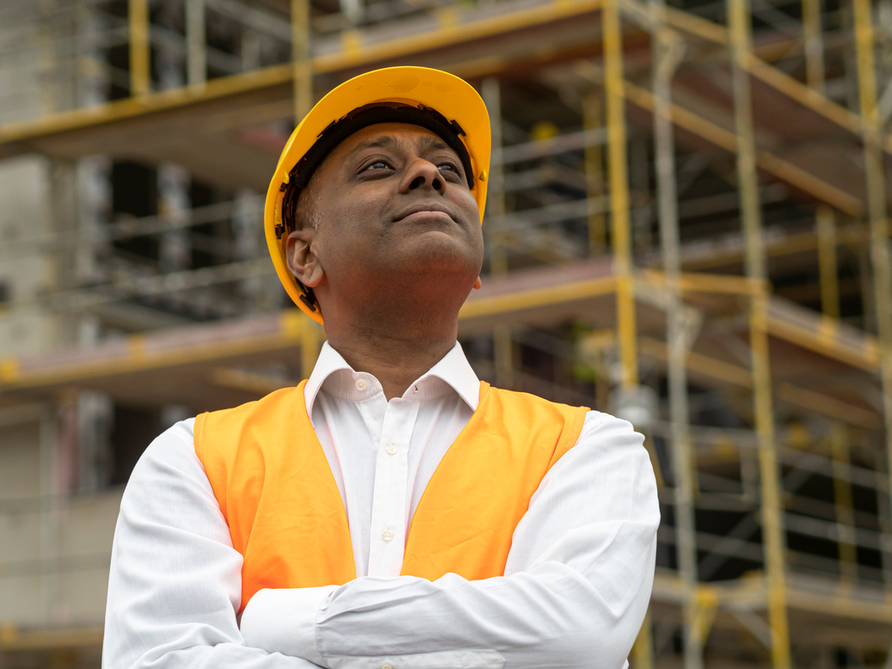
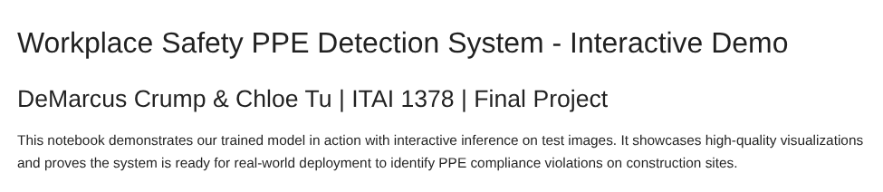
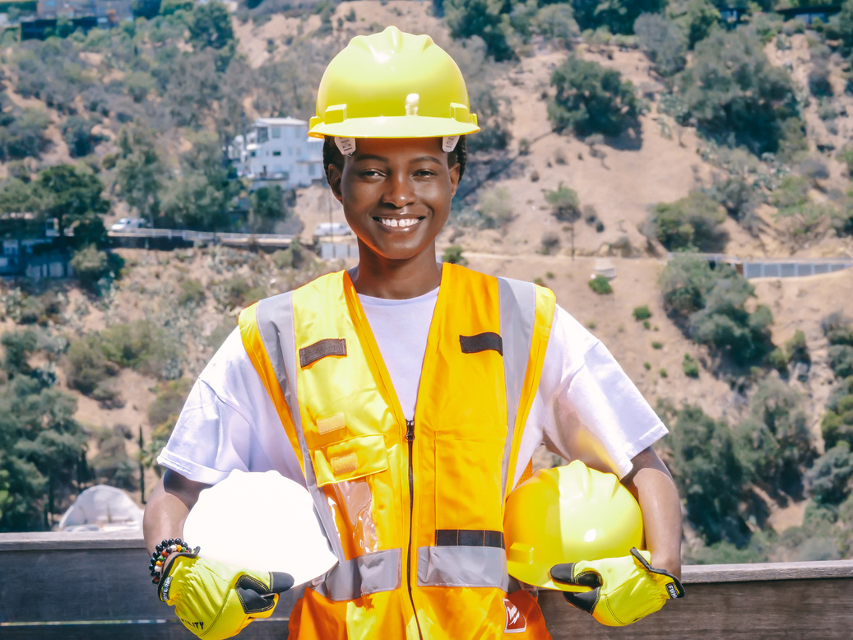
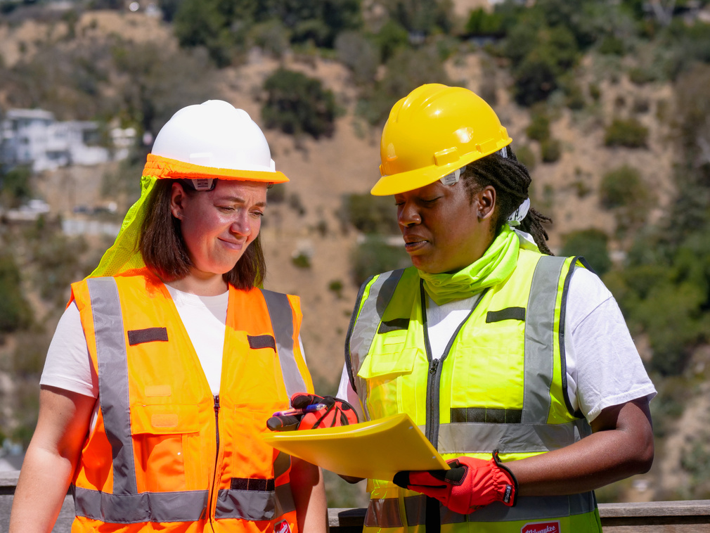
PPE SYSTEM
Home
Services
Features
About Us
Let’s Talk
LIVE DEMO
Running 04_demo.ipynb: Testing on External Construction Site Images
Demo Plan:
1. Load trained model
2. Test Case 1: Workers with proper PPE
3. Test Case 2: Safety violation (NO-Hardhat)
4. Test Case 3: Multiple workers (crowded scene)

Slide 8
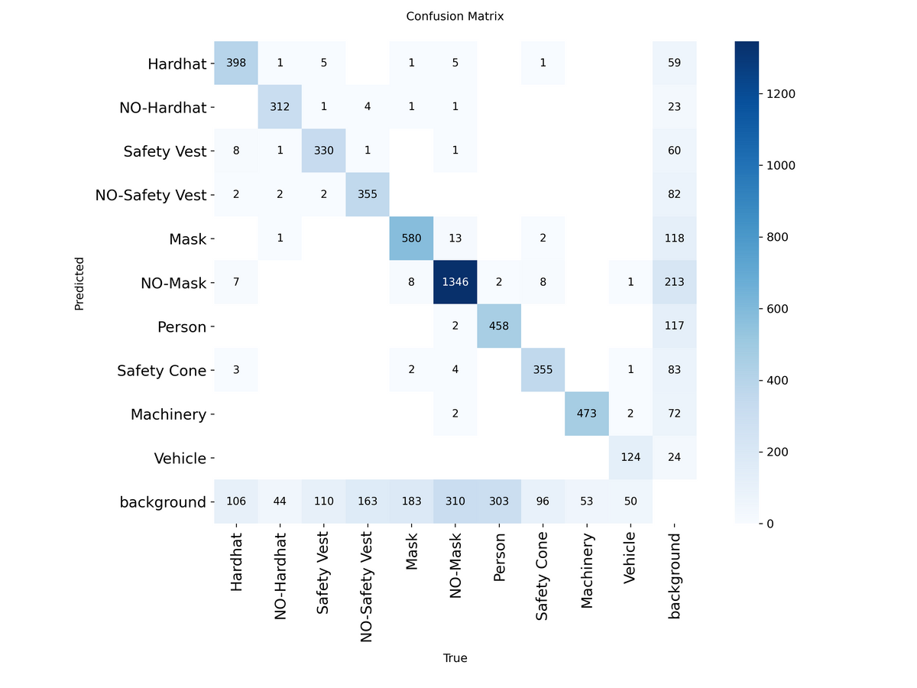
PPE SYSTEM
Home
Services
Features
About Us
Let’s Talk
Per-Class Performance:
RESULTS - METRICS
High accuracy on Hardhats (85%)
High accuracy on Safety Vests (83%)
Various lighting conditions
Multiple workers simultaneously
Context objects (cones, machinery)
Overall Metrics (Test Set):
Metric | Value | What It Means
mAP@50 | 77.1% | Primary accuracy metric
Precision | 88.9% | Low false alarms (reliable)
Recall | 68.9% | Catches most violations
Inference Time | 15ms | Real-time capable
FPS | 66 | Processes video smoothly
Comparison:
Availability | Method | Value | Accuracy
Business hours | Manual Inspection | 20 sec/person | ~65%
24/7 | Our System | 0.015 sec | 77.1%
Continuous | Improvement | 2000x faster | +12%

Slide 9
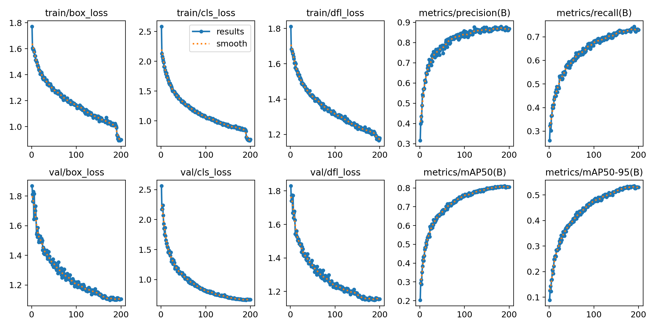
PPE SYSTEM
Home
Services
Features
About Us
Let’s Talk
RESULTS - SUCCESS/FAILURE CASES
Success Cases:
✓ Works Well:
High accuracy on Hardhats (85%)
High accuracy on Safety Vests (83%)
Various lighting conditions
Multiple workers simultaneously
Context objects (cones, machinery)
✗ Challenges:
Small objects (distant masks < 32x32 px)
Occlusion (workers blocked by machinery)
Crowded scenes (10+ workers)
Unusual poses/angles
Key Insight: "We prioritize precision (88.9%) over recall to avoid false alarms.
In video deployment, multi-frame tracking compensates for single-frame misses."

Slide 10
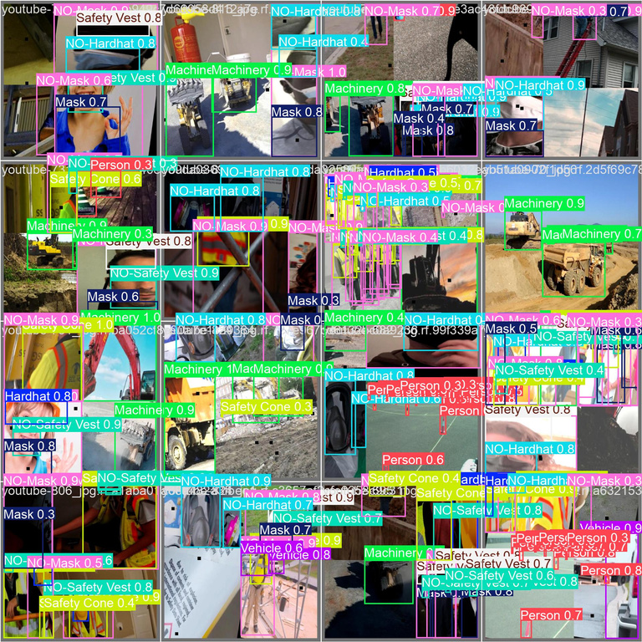
PPE SYSTEM
Home
Services
Features
About Us
Let’s Talk
KEY LEARNINGS
What Worked Well:
What We'd Do Differently:
✓ Stratified Splitting - Balanced class distribution prevented overfitting
✓ Advanced Augmentation - Mixup & copy-paste improved robustness by ~5%
✓ YOLOv8s Choice - Perfect speed/accuracy balance for real-time use
Collect 50% more violation examples (NO-Hardhat, NO-Safety Vest)
Test YOLOv8m for accuracy-critical deployments (sacrifice some speed)
Implement active learning (collect real-world deployment data iteratively)
Challenges Overcome:
⚠ Class Imbalance - Violation classes underrepresented
Solution: Weighted sampling → improved from 65% to 72%
⚠ Small Object Detection - Masks on distant workers
Solution: Tried 800x800 resolution (40% slower) → kept 640x640 for speed
⚠ Colab Session Limits - Training disconnections
Solution: Checkpoint saving every 10 epochs

Slide 11
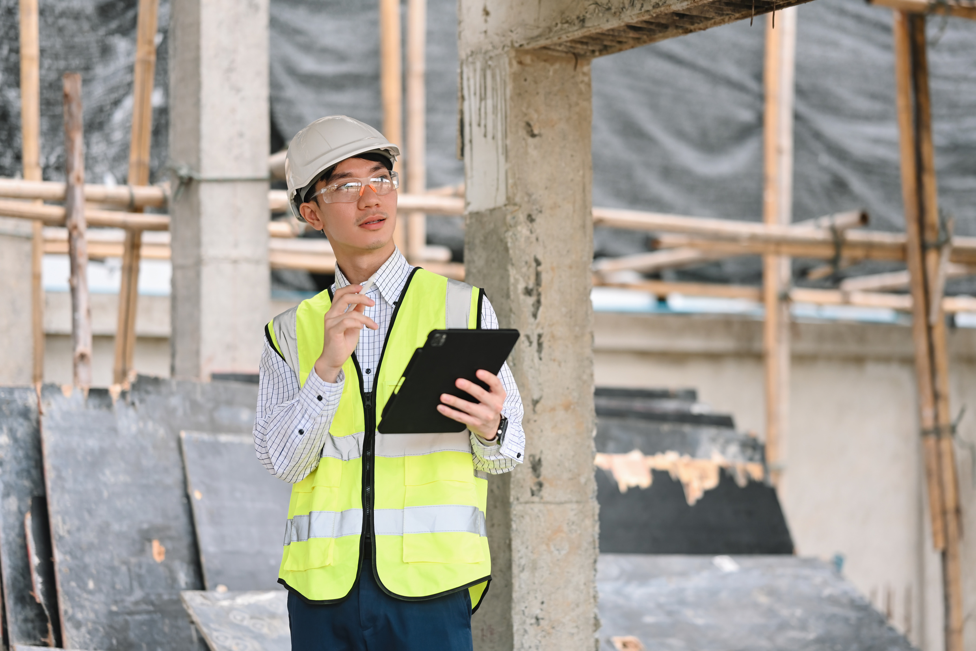
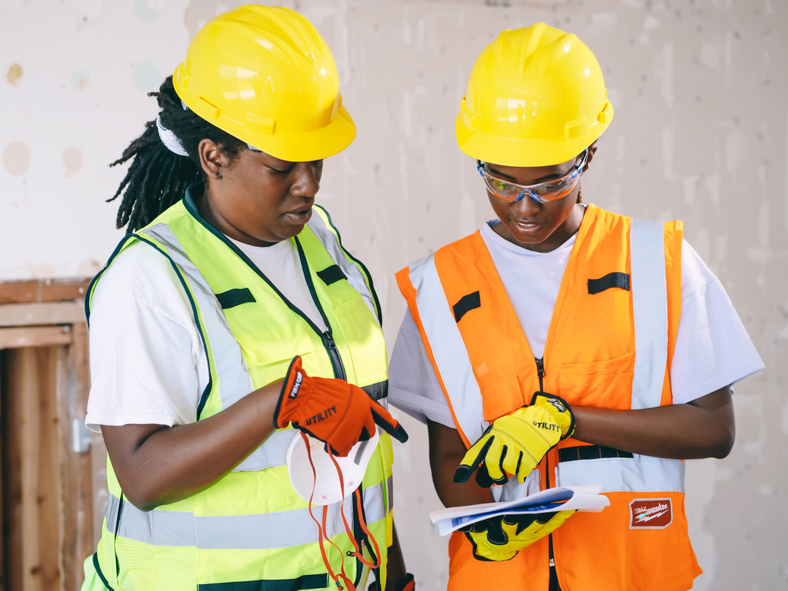
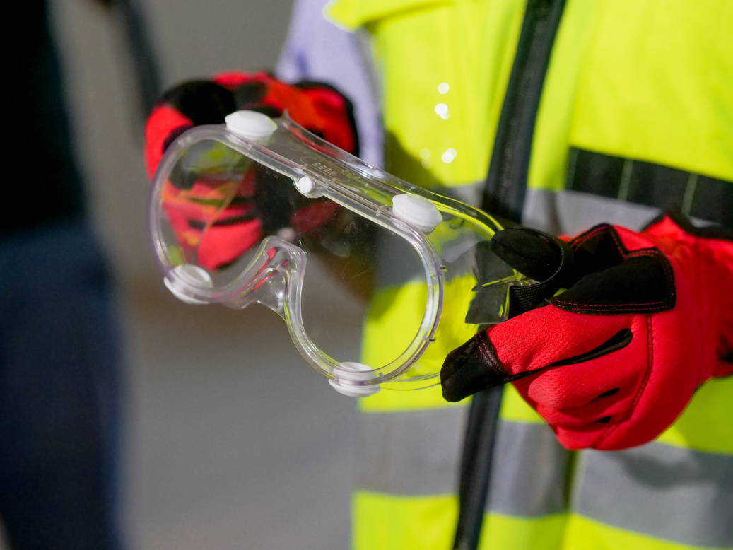
PPE SYSTEM
Home
Services
Features
About Us
Let’s Talk
FUTURE WORK
Future Improvements
1. Expand Dataset with Site-Specific Data
Collect 1,000+ images from target deployment sites
Focus on violation classes and edge cases
Include poor lighting, rain, fog conditions
Expected improvement: +5-7% mAP
2. Implement Multi-Model Ensemble
YOLOv8s for real-time video (66 FPS)
YOLOv8m for critical batch analysis (35 FPS, +4% accuracy)
Ensemble voting to reduce false negatives
3. Deploy Complete Monitoring System
Integrate with surveillance cameras
Temporal tracking (follow workers across frames)
Web dashboard for safety officers
Automated SMS/email alerts
Deploy on edge devices (NVIDIA Jetson)

Slide 12
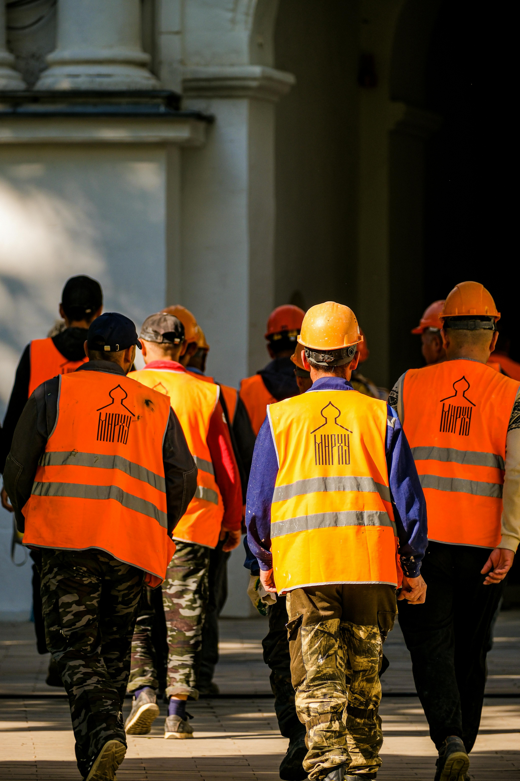
PPE SYSTEM
Home
Services
Features
About Us
Let’s Talk
ACKNOWLEDGMENTS
Course & Instruction:
Professor Patricia McManus- ITAI 1378: Computer Vision
Houston City College - Fall 2025
Data & Tools:
Roboflow & Kaggle - Construction Site Safety Dataset
Ultralytics - YOLOv8 framework
Google Colab - Free GPU access (Tesla T4)
PyTorch - Deep learning infrastructure
AI Assistance (~40% of code):
ChatGPT-4 - Research and debugging
Claude - Documentation and code review
GitHub Copilot - Code completion
Thank you!

Slide 13
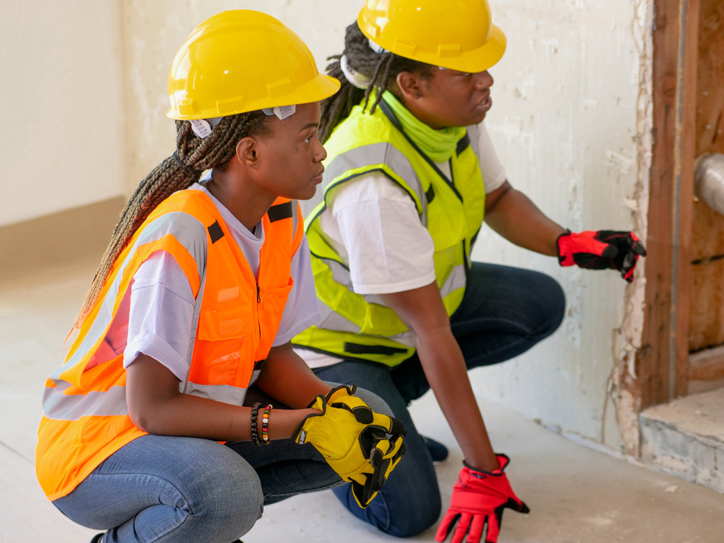
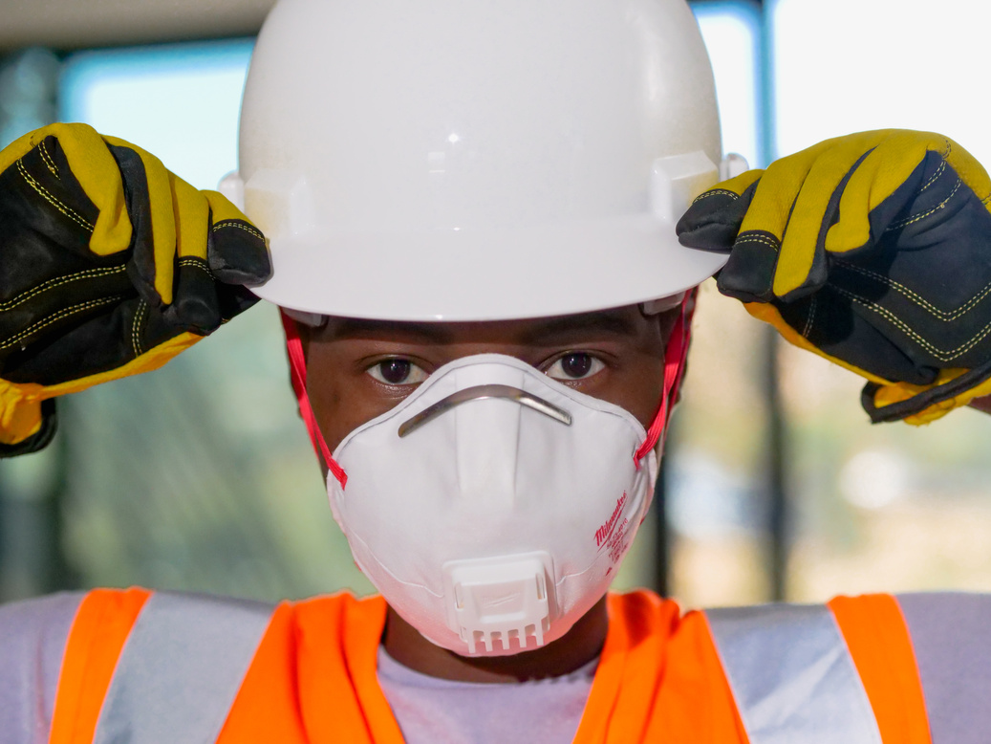
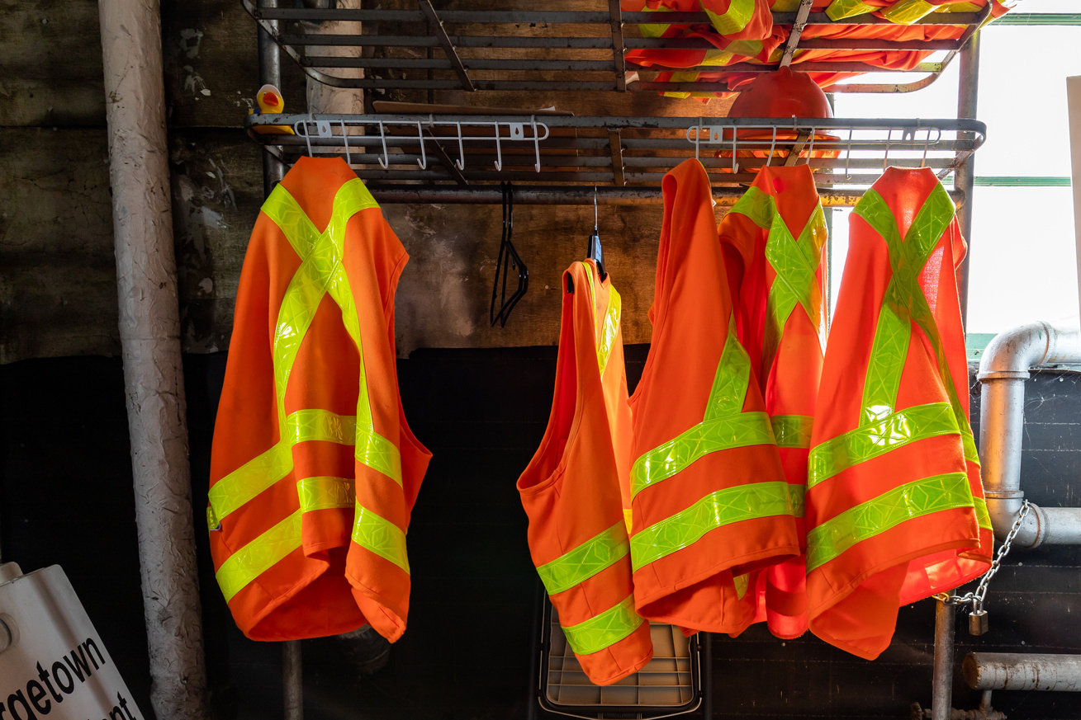
PPE SYSTEM
Home
Services
Features
About Us
Let’s Talk
Q&A EXPECTED QUESTIONS
Q1: "Why did you choose YOLOv8 over other models like Faster R-CNN or Mask R-CNN?"
Q2: "How did you handle class imbalance in your dataset?"
Q3: "What happens if the model makes a false positive—flags someone as non-compliant when they actually are compliant?"
Q4: "Can your model work in poor lighting or bad weather like rain or fog?"
Q5: "How would you actually deploy this in the real world?"
Q6: "Did you consider privacy concerns with constant video monitoring?"
Q7: "What was your biggest technical challenge?"
Q8: "How accurate is 77% really? Is that good enough for safety applications?"
Q9: "How long did training take and what resources did you use?"
Q10: "Can your model detect other safety violations beyond PPE?"

